Slide 1

Machine learning
Summer Internship- 2026
Name: Varsha Sangwan
Supervisor: Prof. Millie Pant
Mentor: Ms. Riya Applied Mathematics & Scientific Computing
Indian Institute of Technology Roorkee
Date of joining- 09-06-2026

Slide 2

Table of CONTENT
1.
Introduction to Machine Learning
6.
Model Tuning(Hyperparameter Tuning)
2.
Data Preprocessing and EDA
7.
Feature Engineering
3.
Supervised Learning ALgorithms
8.
NLP(Natural language Processing)
4.
Unsupervised Learning ALgorithms
9.
Machine Learning Capstone
5.
Model Evaluation
10..
Future work and References

Slide 3
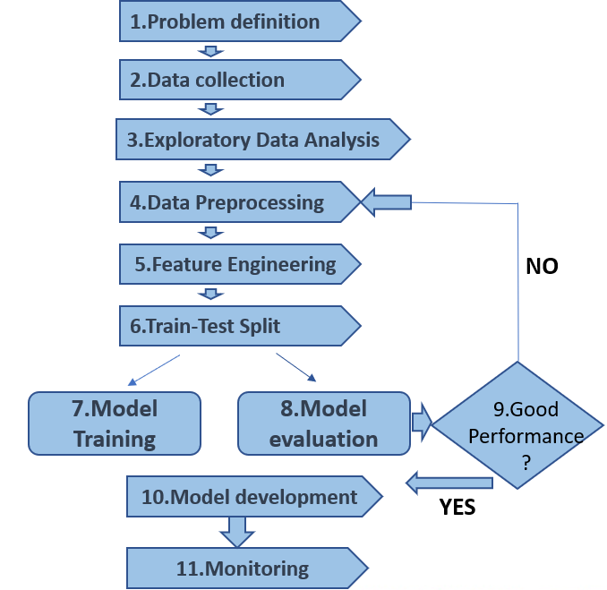
Introduction to Machine Learning
Machine Learning(ML):
is a branch of Artificial Intelligence that allows computers to learn from data, identify patterns, and make predictions or decisions without being explicitly programmed.
Classification
Predicting categories
SUPERVISED LEARNING
Learning with labels. Mapping inputs(features)
to known outputs(labels)for training
Regression
Predicting numbers
Clustering
Grouping data
UNSUPERVISED LEARNING
Learning without labels.
Discovering hidden structures and patterns in the data
Types of machine learning
ML workflow overivew
Dimensionality reduction
REINFORCEMENT LEARNING
Learning by interaction .
Agent receives rewards or penalties for actions to optimize long term goals
1.

Slide 4

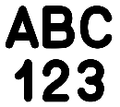


Data Preprocessing and EDA
Data preprocessing- it is about transforming valid data into a usable format
EDA(Exloratory Data Aanaysis)-It’s the step where you explore the data to understandit,discover patterns,spot anomlies ,generate insights and decide what to do next.
Handling missing values:
Deletion (Dropping the Data) dropna()
Basic Imputation (Filling the Blanks) fillna()
Encoding categorical values : convert text labels into numbers
1.Label Encoding
2.One-Hot Encoding
Feature scaling: Bring numerical values to the same scale
1.Normalization (MinMax _Scaler)
2.Standardization(Standard_Scaler)
Train-test split: is a technique used to evaluate the performance of a machine learning model. It involves taking your single master dataset and dividing it into two separate subsets: one to build the model, and one to test it.
2.

Slide 5
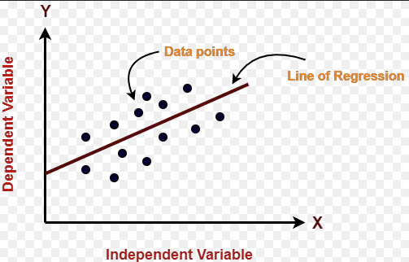
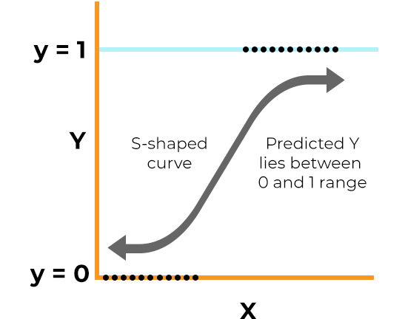
Supervised learning algorithms
Linear regression
Predict a numerical value by finding the best fitting straight line.
This is used for regression
Regresion line eqn: y=mx+c
Example:House price prediction
Logistic regression
Used for classification problem when the output has two classes.
It uses sigmoid function that converts any real no. into a value between 0 and 1
Example: Spam vs Not Spam
3.

Slide 6
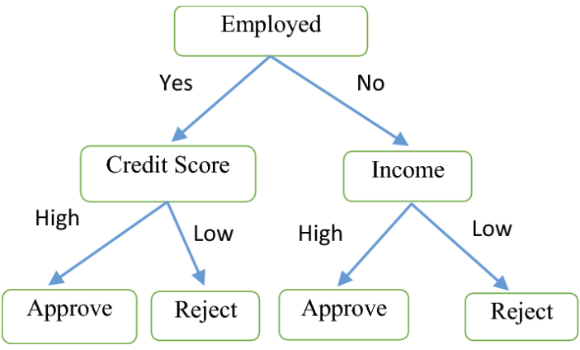
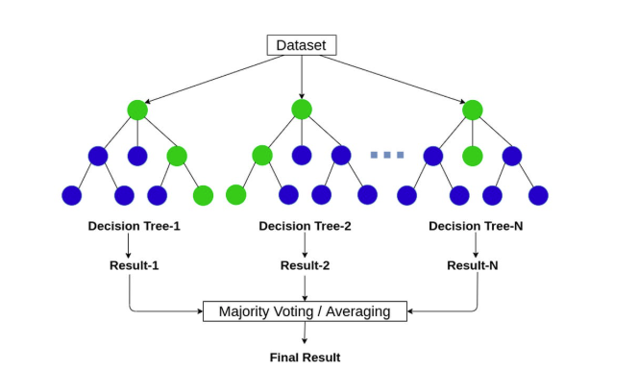
Supervised learning Algorithms
Decision Tree
Splits data into branches based on feature value
Used for Classification and regression tasks
Example: Loan approval
Random forest
Combines predictions from many decision trees
Used for Classification and regression tasks
Example: Fraud detection
4.

Slide 7
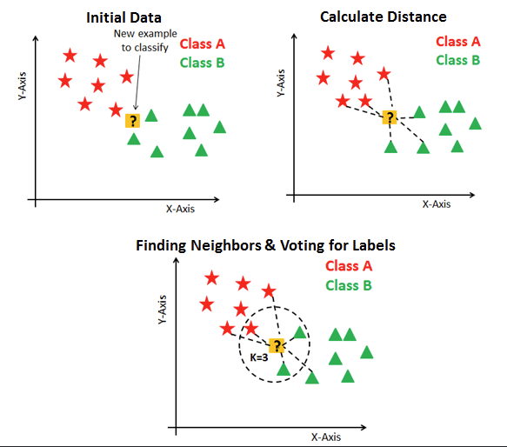
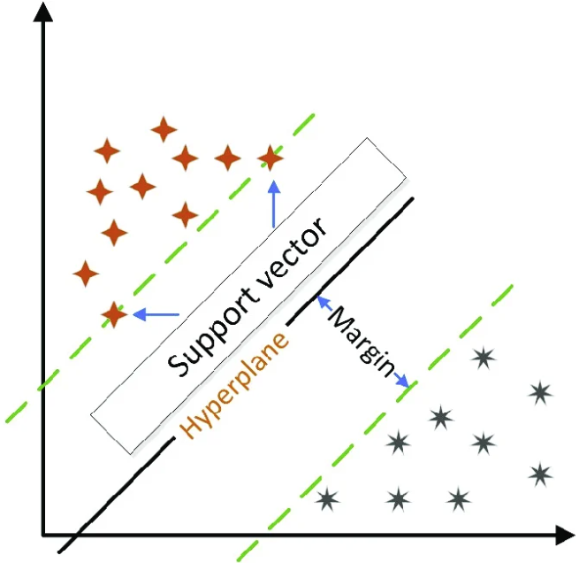
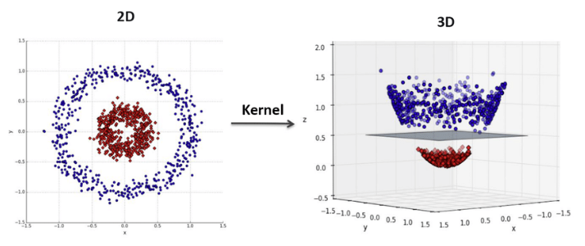
Supervised Learning Algorithm
K-Nearest Neighbours(kNN)
Predicts based on the majority class (or average) of the nearest neighbors
Used for Classification & Regression tasks
Example: Handwriting Recognition
Support Vector Machine (SVM)
Finds the optimal hyperplane with the maximum margin between classes
Used for Classification (mainly)
Example: Face recognition
5.

Slide 8
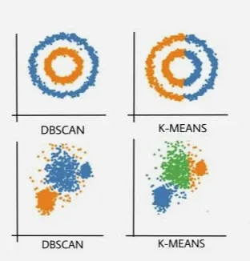
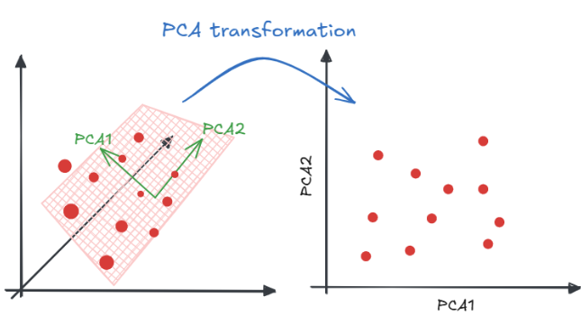
Unsupervised Learning Algorithms
K-Means clustering: is the most popular clustering algorithm. It divides data into K-clusters, where each cluster contains similar data points.
Elbow Method helps determine the best value of K
Example: Market analysis
DBSCAN(Density Based Spatial clustering of Applications): groups data based on density rather than distance from a centroid. Uses : min_samples and
eps (ε)
Example: Earthquake detection
PCA(Principal Components Analysis):is a dimensionality reduction technique that reduces the number of features while preserving most of the important information.
Example: Noise reduction
6.

Slide 9
Model Evaluation
Model evaluation is the process of using various metrics to measure how well a machine learning model performs.
Evaluation Metrics
Classification Metrics
(Predicting Categories)
Confusion Matrix
Precision
Recall
F1-Score
ROC-AUC
Regression Metrics
(Predicting Numbers)
Mean Absolute Error (MAE)
Mean Squared Error (MSE)
Root Mean Squared Error (RMSE)
R-squared
7.

Slide 10
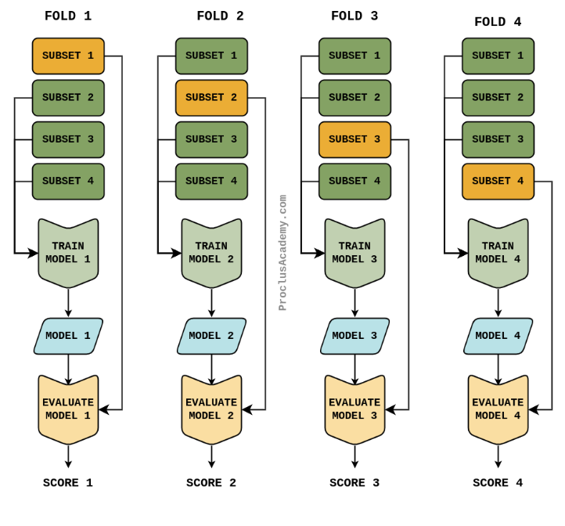
Cross Validation
Cross validation is a statistical method used to evaluate oe well your model will perform on entirely new , unseen data.
4-fold Cross Validation:
8.

Slide 11
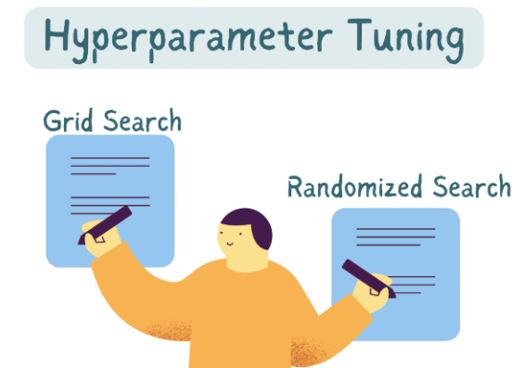
Model Tunning(Hyperparameter Tuning)
Hyperparameter tuning is the process of finding the absolute best combination of these settings to get the highest performance out of your model.
9.

Slide 12
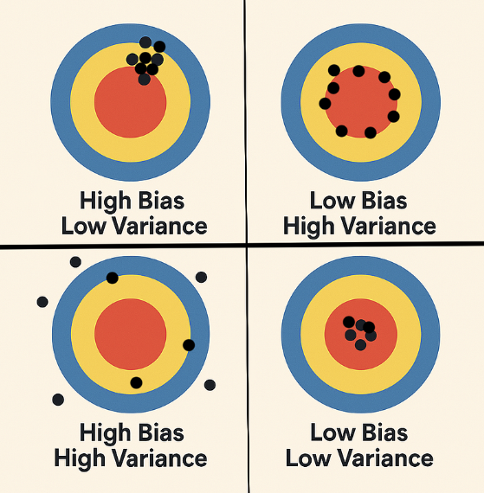
Bias-Variance Tradeoff
The Bias-Variance Tradeoff : It describes the delicate balancing act you must perform to build a model that is smart enough to learn the underlying patterns in your data, but not so "over-memorized" that it fails when it sees new data.
a tradeoff in machine learning is a compromise
10.

Slide 13
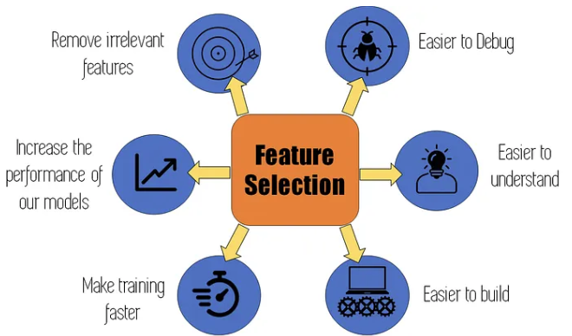
Feature Engineering
Feature engineering is the process of using domain knowledge to select, modify, or create new variables (features) from your raw data to make machine learning algorithms work better.
11.

Slide 14
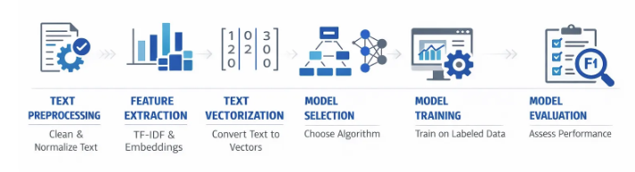
NLP(Natuiral language processing)
Natural Language Processing (NLP) is a branch of artificial intelligence that focuses on the interaction between computers and human language. Its primary goal is to enable machines to read, understand, interpret, and generate human language in a way that is valuable and contextually accurate
12.

Slide 15
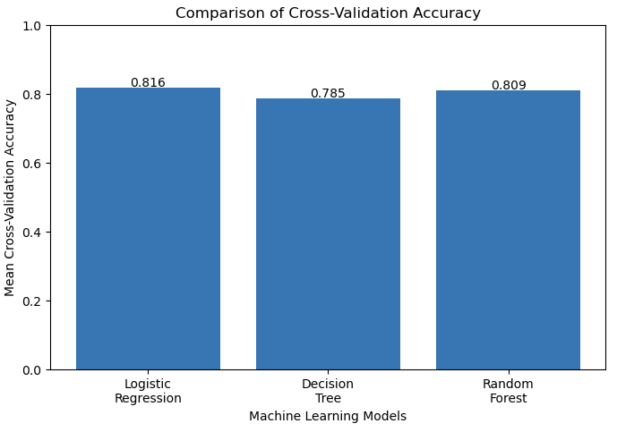
Machine Learning capstone
Titanic Survival Prediction Using Machine Learning
Problem Statement
The objective of this project was to develop a machine learning model that predicts whether a passenger survived the Titanic disaster based on passenger information such as passenger class, gender, age, fare, family members traveling together, and embarkation details. This is a binary classification problem where the target variable is survived (0 = Did Not Survive, 1 = Survived).
Results
The exploratory data analysis revealed that female passengers and first-class passengers had a higher survival rate than male passengers and third-class passengers. Among the three machine learning algorithms, the Random Forest Classifier achieved the highest prediction accuracy and produced the most reliable results during cross-validation.
Results before cross validation:
Logistic Regression Accuracy: 81.01%
Decision Tree: 65.92%
Random Forest Accuracy: 82.68%
13.

Slide 16
Future work and References
Future work:
Predictive Maintenance model for Stone Crusher Machines
To predict failure of the machine
References:
Book: Machine Learning For Absolute beginners: A plain English introduction, Oliver Theobald,second edition
Kaggle Datasets — https://www.kaggle.com/datasets
Scikit-learn— https://scikit-learn.org/stable/modules/preprocessing.html
14.

Slide 17


